Slide 1
Git and GitHub

Slide 2
Git and GitHub
Agenda:
What is Git and Github
Why do we need Git and Github
How to use git and github
Create github account
Create a small project and add it to github

Slide 3
Git and GitHub
What is Version Control?
Version control is a system that records changes to a file or set of files over time so that you can recall specific versions later.
So ideally, we can place any file in the computer on version control.
The reason:
A Version Control System (VCS) allows you to revert files back to a previous state, revert the entire project back to a previous state, review changes made over time, see who last modified something that might be causing a problem, who introduced an issue and when, and more.

Slide 4
Git and GitHub
Using a VCS also means that if something goes wrong, like you lose files, for example, you can generally recover easily.
What is Git?
Git is a version-control system for tracking changes in computer files and coordinating work on those files among multiple people.
Git is a Distributed Version Control System. Which means Git does not necessarily rely on a central server to store all the versions of a project’s files.

Slide 5
Git and GitHub
Instead, every user “clones” a copy of a repository (a collection of files) and has the full history of the project on their own hard drive.
This clone has all of the metadata of the original while the original itself is stored on a self-hosted server or a third-party hosting service like GitHub.
Git helps you keep track of the changes you make to your code. It is basically the history tab for your code editor
If at any point while coding you hit a fatal error and don’t know what’s causing it you can always revert back to the stable state.

Slide 6
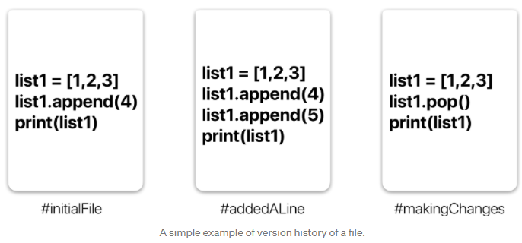
Git and GitHub
So it is very helpful for debugging. Or you can simply see what changes you made to your code over time.

Slide 7
Git and GitHub
In the example in the previous slide, all three cards represent different versions of the same file.
We can select which version of the file we want to use at any point in time. So I can jump to and fro to any version of the file in the git time continuum.
Git also helps you synchronise code between multiple people.
So imagine you and your friend are collaborating on a project. You both are working on the same project files

Slide 8
Git and GitHub
Now Git takes those changes you and your friend made independently and merges them into a single “Master” repository.
So by using Git you can ensure you both are working on the most recent version of the repository.
So you don’t have to worry about mailing your files to each other and working with a ridiculous number of copies of the original file.
And collaborating long-distance becomes easy

Slide 9
Git workflow

Slide 10
Git and GitHub
What is a Repository?
A repository a.k.a. repo is nothing but a collection of source code.
There are four fundamental elements in the Git Workflow.
Working Directory, Staging Area, Local Repository, and Remote Repository.

Slide 11
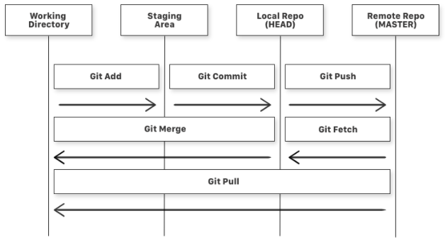
Git and GitHub

Slide 12
Git and GitHub
If you consider a file in your Working Directory, it can be in three possible states -
It can be staged. This means the files with the updated changes are marked to be committed to the local repository but not yet committed.
It can be modified. This means the files with the updated changes are not yet stored in the local repository.
It can be committed. This means that the changes you made to your file are safely stored in the local repository.

Slide 13
Git and GitHub
Some further explanations -
git add is a command used to add a file that is in the working directory to the staging area.
git commit is a command used to add all files that are staged to the local repository.
git push is a command used to add all committed files in the local repository to the remote repository. So in the remote repository, all files and changes will be visible to anyone with access to the remote repository.

Slide 14
Git and GitHub
git fetch is a command used to get files from the remote repository to the local repository but not into the working directory.
git merge is a command used to get the files from the local repository into the working directory.
git pull is a command used to get files from the remote repository directly into the working directory. It is equivalent to a git fetch and a git merge .
Now that we know what Git is and its basic terminologies, let’s see how we can place a file under git. We’re going to do it the right way and the difficult way. Without any GUI applications.

Slide 15
Git and GitHub
BUT WHAT IS GITHUB?
Git is a tool. GitHub is the name of the software and the company that uses git (a tool) to give us many valuable services.
There are many git based online platforms / services. For example, GitLab, BitBucket, etc.
GitHub is probably the most popular one. So this is what we will explore in this class.

Slide 16
Getting started

Slide 17
GitHub
Go to github.com and make a free account.
Take some time to explore the website.

Slide 18
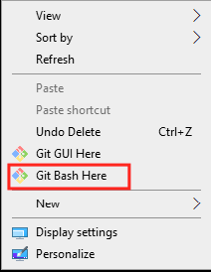
GitHub
Download git in your machine from here.
Install git by following the installer. Go with the default options.
When done, a restart may be required.
Now, you can test installation by right clicking in a folder -
Type git --version (command line interface)

Slide 19
GitHub
Now we need to connect this with your github account.
For that, open git bash and type these commands –
git config --global user.name "YourName"
git config --global user.email testemail@mail.com
git config –global color.ui auto
git config --list (To check the configuration)

Slide 20
GitHub
To create working directory type: mkdir name (project folder name)
To go to a folder: cd foldername
Go back: cd ..
To check the list of folders in a directory: ls
To initialize working directory as git repo type: git init
To check the initialization type: ls -a
To remove initialization type: rm -rf .git
To create file in local repo type: touch filename.extension
To add file to staging area: git add filename.extension
To add all files from the project folder to staging area: git add .

Slide 21
GitHub
To see what file in staging area: git status
To remove a file from staging area type
git rm --cached filename.extension
To remove all file from staging area: git rm -r --cached .
To commit the change: git commit -m "First commit"

Slide 22
GitHub
Now your local repository is ready to push to remote repository in github.
To do that create a new repository in github.
Follow the “push an existing repository” steps
To push local repo to remote repo: git push
Now you can see copy of our working directory in github repo
Every time you make change in local repo to see the changes in remote repo, the process is
Add the file to staging area > commit with comment> git push

Slide 23
Git Reset and Revert:

Slide 24
GitHub
Git Reset and Revert:
Reset(when change has been committed but not pushed to remote repo):
To see log: git log
To reset: git reset HEAD~1
To reset working directory: git checkout (log #) -- (file name)
Revert (when change has been committed and pushed to remote repo):
git revert (log #)

Slide 25
Next steps...

Slide 26
GitHub
When we push changes to remote repo, main branch gets updated. Best practice is to create separate branch and push the changes their. In that case, you have the opportunity to review the changes. If you think the changes, you made is right, we can merge it to main branch.
Create new branch in remote repo
To see the changes in local repo: git pull
To sell all branches: git branch –r
To switch branch: git checkout branchname

Slide 27
Working on other repos

Slide 28
GitHub
Cloning a Git Repo:
Locate to the directory you want to clone the repo. Copy the link of the repository you want and enter the following:
git clone remote_repository_URL
Try it with this repo (or any other repo).
Now you can work on the files you want and commit to changes locally.
If you want to push changes to that repository you either have to be added as a collaborator, which we will discuss later.

Slide 29
GitHub
Now we are going to do it in easy way using git GUI.

Slide 30
Classwork

Slide 31
Classwork
Add all you projects to github. Make sure to add meaningful readme files to them.
Do that by adding readme.md files to your projects.
In addition, give meaningful names to your repositories too.

Slide 32
Thank you!

